Slide 1
STUDENT NAME:R.Mohammed AKRAM
Final project

Slide 2
WANNACRY RANSOMWARE ATTACK(2017)

Slide 3
AGENDA
RANSOMWARE OVERVIEW
CAUSE OF THE ATTACK
CONSEQUENCES OF THE ATTACK
HOW THE ATTACK WAS STOPPED
FURTHER PRECAUTIONS WHICH WILL STOP THE RANSOMWARE ATTACK
OVERVIEW ABOUT SOCIAL ENGINEERING

Slide 4
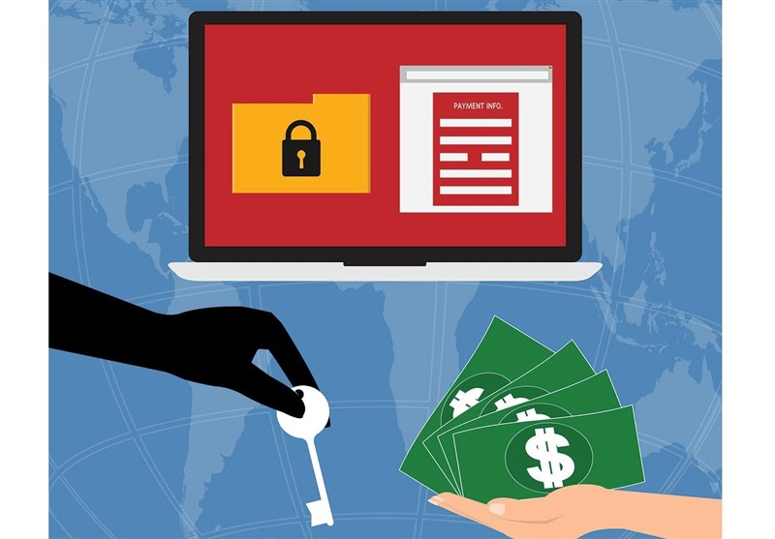
RANSOMWARE
Ransomware is a type of malicious software (malware) designed to deny access to a computer system or files until a ransom is paid. It is a significant cybersecurity threat that has evolved over the years, posing serious risks to individuals, businesses, and even critical infrastructure.
This Photo by Unknown Author is licensed under CC BY

Slide 5
How Ransomware Works:
Infection: Ransomware typically infects a computer system through phishing emails, malicious links, or exploit kits targeting vulnerabilities in software or operating systems.
Encryption: Once installed on a victim's system, ransomware encrypts files, rendering them inaccessible without the decryption key. Some ransomware variants may also lock the entire system, preventing users from accessing their devices.
Ransom Demand: After encryption, the ransomware displays a ransom note, usually demanding payment in cryptocurrencies such as Bitcoin or Monero. The ransom note provides instructions on how to pay the ransom and receive the decryption key.
Payment and Decryption: If the victim chooses to pay the ransom, they receive the decryption key from the attackers, allowing them to regain access to their files or system. However, there is no guarantee that paying the ransom will result in the decryption of files, and it may also encourage further attacks.

Slide 6
WANNACRY RANSOMWARE
The WannaCry ransomware attack, which occurred in May 2017, was one of the largest and most widespread cyberattacks in history.
Overview:
Discovery: WannaCry ransomware was first detected on May 12, 2017, when it began infecting computers worldwide.
Propagation: It spread rapidly through a worm-like mechanism, exploiting a vulnerability in Microsoft Windows operating systems, particularly targeting computers running older versions such as Windows XP and Windows 7.
Attack Vector: WannaCry exploited a vulnerability named EternalBlue, which was believed to be developed by the U.S. National Security Agency (NSA). The vulnerability was leaked by a hacker group known as the Shadow Brokers.
Encryption and Ransom: Once installed on a computer, WannaCry encrypted files and demanded ransom payments in Bitcoin in exchange for decryption keys. The ransom amount typically started at $300 and increased over time if the victim did not pay promptly.

Slide 7
Impact:
Global Reach: The attack affected hundreds of thousands of computers in over 150 countries, including businesses, government agencies, hospitals, and critical infrastructure.
Disruption of Services: WannaCry disrupted operations in various sectors, including healthcare, finance, transportation, and telecommunications.
Financial Losses: The total financial impact of the WannaCry attack is estimated to be in the hundreds of millions of dollars, considering factors such as ransom payments, lost productivity, and remediation costs.
Public Awareness: The widespread media coverage of WannaCry raised public awareness about cybersecurity threats and the importance of keeping software systems updated.

Slide 8
Response:
Emergency Patches: In response to the WannaCry attack, Microsoft released emergency security patches to address the vulnerability exploited by the ransomware. Even for unsupported versions like Windows XP, Microsoft issued patches to mitigate the risk.
Law Enforcement Action: Law enforcement agencies, cybersecurity firms, and international organizations collaborated to investigate the attack and disrupt the operations of WannaCry's perpetrators.
Debate on Responsible Disclosure: The WannaCry incident sparked debates about responsible disclosure of software vulnerabilities and the role of governments in developing and stockpiling cyber weapons.

Slide 9
Lessons Learned:
Importance of Patch Management: The WannaCry attack underscored the critical importance of promptly applying security patches and updates to software systems to mitigate the risk of exploitation by cyber threats.
Need for Cyber Hygiene: Organizations and individuals learned the importance of practicing good cyber hygiene, such as regular data backups, robust security measures, and user awareness training to prevent and respond to ransomware attacks.
Collaboration and Information Sharing: The incident highlighted the need for collaboration among governments, industry partners, and cybersecurity experts to address global cyber threats effectively.

Slide 10
SOLUTIONS TO PREVENT RANSOMWARE ATTACKS
Technical Solutions:
Patch Management:
Promptly apply security patches and updates to operating systems, software, and firmware to address known vulnerabilities, including those exploited by ransomware like EternalBlue.
Endpoint Security Solutions:
Deploy robust endpoint protection solutions, such as antivirus software, intrusion detection systems (IDS), and endpoint detection and response (EDR) tools, to detect and block ransomware threats.
Email Filtering and Web Filtering:
Implement email filtering solutions to block phishing emails containing malicious attachments or links that may deliver ransomware payloads.
Use web filtering to restrict access to malicious websites hosting exploit kits or malware downloads.
Backup and Recovery:
Regularly back up critical data and systems to offline or cloud storage to mitigate the impact of ransomware attacks.
Ensure backups are securely stored and regularly tested to verify their integrity and effectiveness in restoring data.
Network Segmentation:
Segment network infrastructure to isolate critical systems and sensitive data from less secure or vulnerable parts of the network, reducing the spread of ransomware infections.
Least Privilege Access:
Follow the principle of least privilege by restricting user access to only the resources and privileges necessary for their roles and responsibilities, limiting the potential impact of ransomware attacks.

Slide 11
User Education and Awareness:
Security Training:
Provide regular security awareness training to employees to educate them about common ransomware tactics, such as phishing emails, and how to recognize and respond to potential threats.
Phishing Simulations:
Conduct phishing simulation exercises to test employees' ability to identify phishing attempts and reinforce best practices for avoiding ransomware infections.
Reporting Mechanisms:
Encourage employees to report suspicious emails, messages, or activities to the IT or security team for investigation and response.

Slide 12
Incident Response and Recovery:
Incident Response Plan:
Develop and maintain an incident response plan outlining procedures for detecting, containing, and recovering from ransomware attacks. Ensure clear roles and responsibilities are defined, and the plan is regularly tested and updated.
Communication and Coordination:
Establish communication channels and coordination mechanisms with relevant stakeholders, including IT teams, management, law enforcement, and incident response partners, to facilitate a coordinated response to ransomware incidents.
Forensic Analysis:
Conduct forensic analysis of ransomware incidents to identify the root cause, assess the extent of the damage, and gather evidence for potential legal or law enforcement actions.
Negotiation and Recovery:
Consider engaging with law enforcement and third-party experts for assistance in negotiating with ransomware operators and recovering encrypted data, although paying ransom should be avoided whenever possible.

Slide 13
THANK YOU

